Slide 1
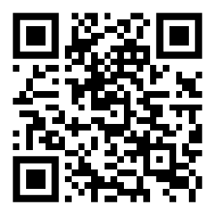
October 21-22, 2022
Virtual and In-Person
(DoubleTree by HiltonTM West Edmonton)
peerevidence.ca/peip

