Slide 1
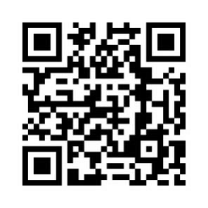
October 20-21, 2023
In person or Live Webcasting
peerevidence.ca/peip

